Slide 1
Twitter Sentiment Analysis with News & Weather

Slide 2


Sowmya
Vijayakumar
Dhavala
Manjunatha
Stevens Institute of Technology, NJ

Slide 3
What’s this about?

Slide 4

Want big impact?
Use big image.

Slide 5


How’s NYC feeling today?

Slide 6



Slide 7



Slide 8

Data Collection

Slide 9






GNIP Tool
9

Slide 10

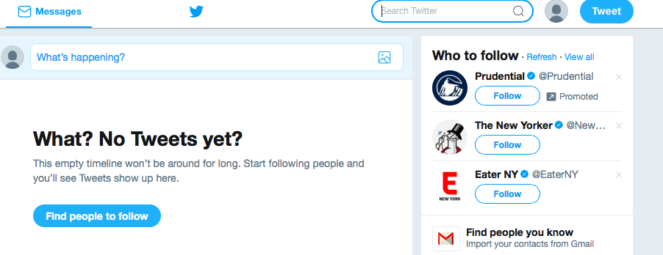
Mimic Twitter search through browser

Slide 11

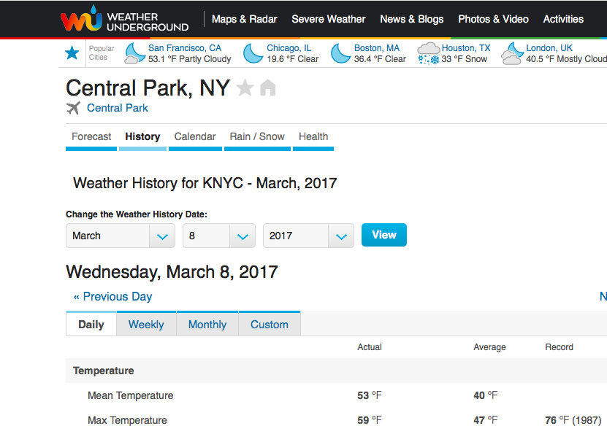

Slide 12




Slide 13
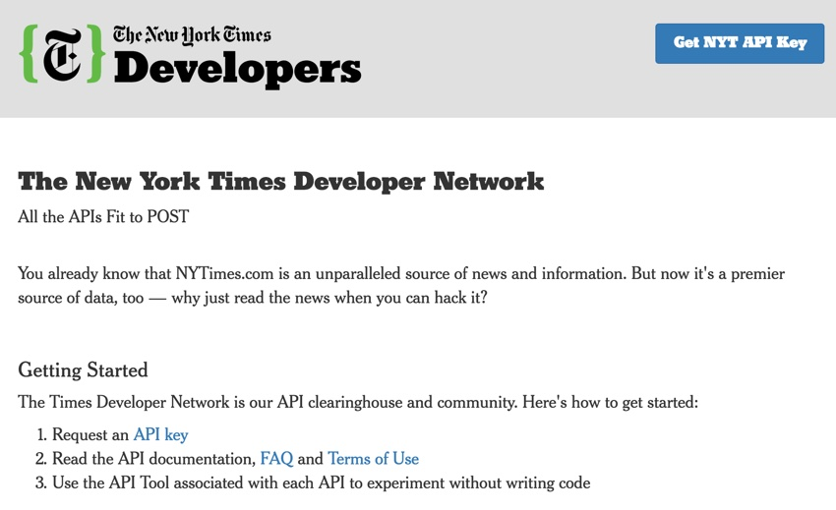
You can also split your content

Slide 14

Data Cleaning

Slide 15
JSON > CSV
!*@#$&
Date Formatting
http://

Slide 16
Data Processing

Slide 17

Python Pandas
SentimentIntensityAnalyzer
TextBlob

Slide 18
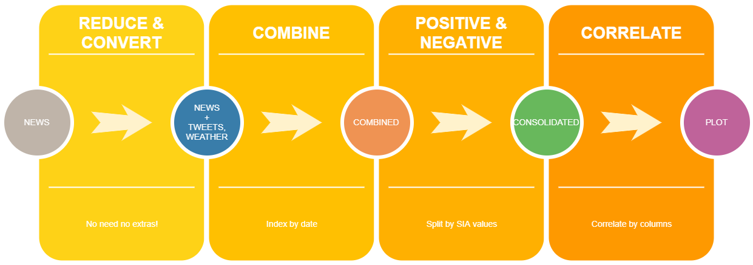

Slide 19
Results

Slide 20
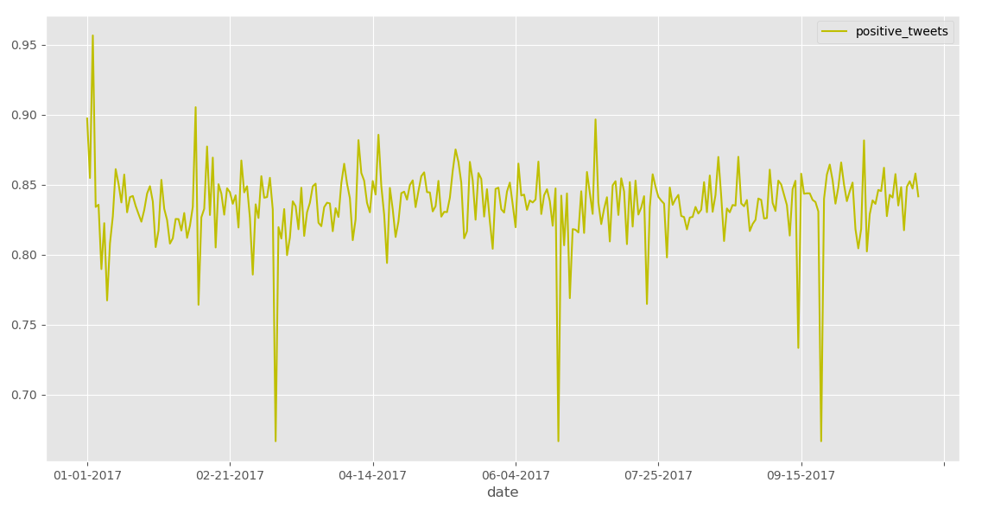

Slide 21
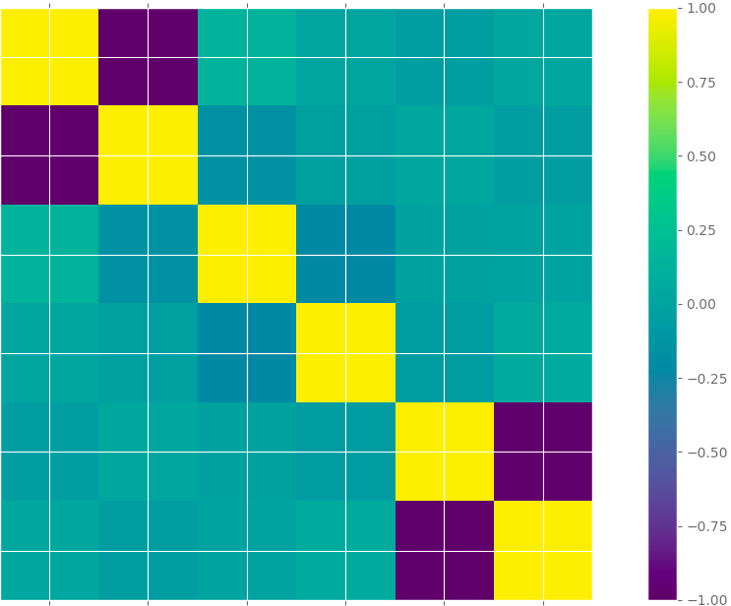
Positive
News
Positive
Tweets

Slide 22
Looking Forward!

Slide 23




Slide 24
Thanks!
Any questions?
You can find us at:
dmanjuna@stevens.com
svijayak@stevens.com
Github:
https://github.com/sowmyavj/Python-Project

Slide 25
Credits
Special thanks to all the people who made and released these awesome resources for free:
Presentation template by SlidesCarnival
Photographs by Unsplash
Watercolor textures by GraphicBurguer

